Slide 1





Project StayMore
Powered by:
Supporting data driven business decision making in the short-term rental industry
BI & Analytics Academy, C1, Team 7 21-12-2020
Project Future
5ος κύκλος
ΤΡΑΠΕΖΑ ΠΕΙΡΑΙΩΣ

Slide 2





Meet the
Project Team
Stauros Gasparis
Data Engineer
Klevis Kasai
ML Engineer
Vasilis Depastas
Data Engineer
Maria Anagnostou
ML Engineer
Ilias Zografos
BI Analyst

Slide 3
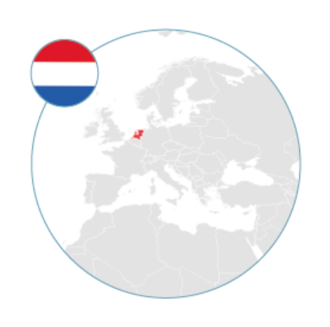

Project Scenario
StayMore: a fast-growing Amsterdam-based online short-term rental company
5 BI & Analytics students
Company
Data
Data-driven Decision making system
Traditional Decision Making System
Guests
Hosts
Properties
BI System
System
Mix

Slide 4







Business needs
Top priced properties
Top rated properties
Busiest hosts
Properties’ most critical attributes for price
Undervalued
properties
Overvalued properties
Notify high-rated, undervalued properties’ hosts to increase their price

Slide 5
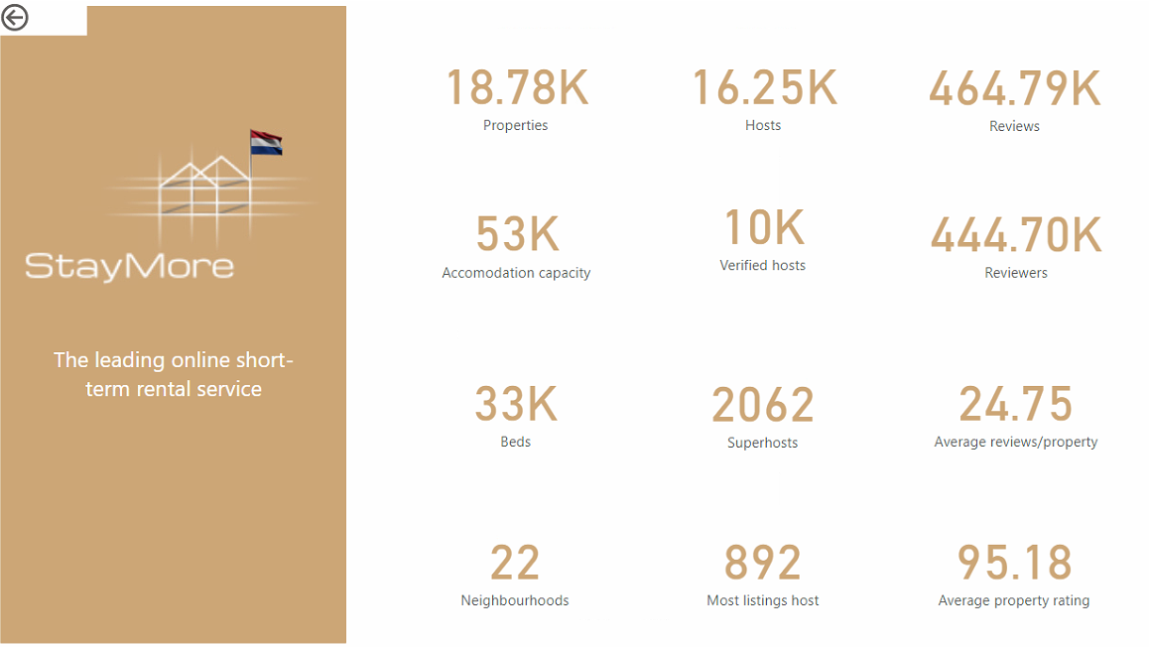
Data Description

Slide 6
Data Warehouse Architecture
Remove inconsistencies and redundancies.
Conform to the Data Warehouse Fact Constellation schema.
Subject oriented
ETL
Integrated
1NF
OLTP
Staging
Transform & Load
DW
Extraction
Notes:
Subject oriented
Integrated
Time variant
Nonvolatile
Summarized
etc

Slide 7
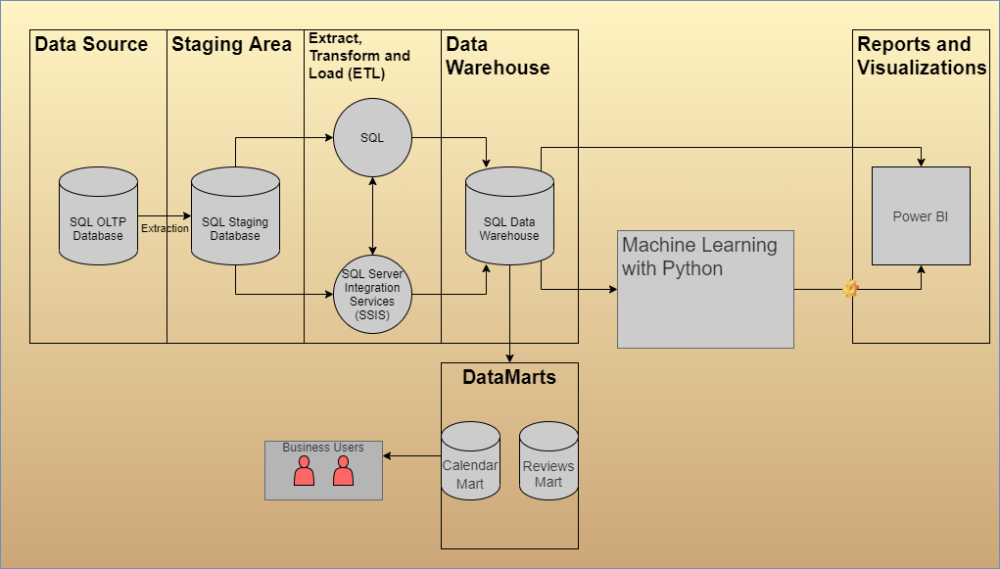
Proposed BI System Architecture

Slide 8
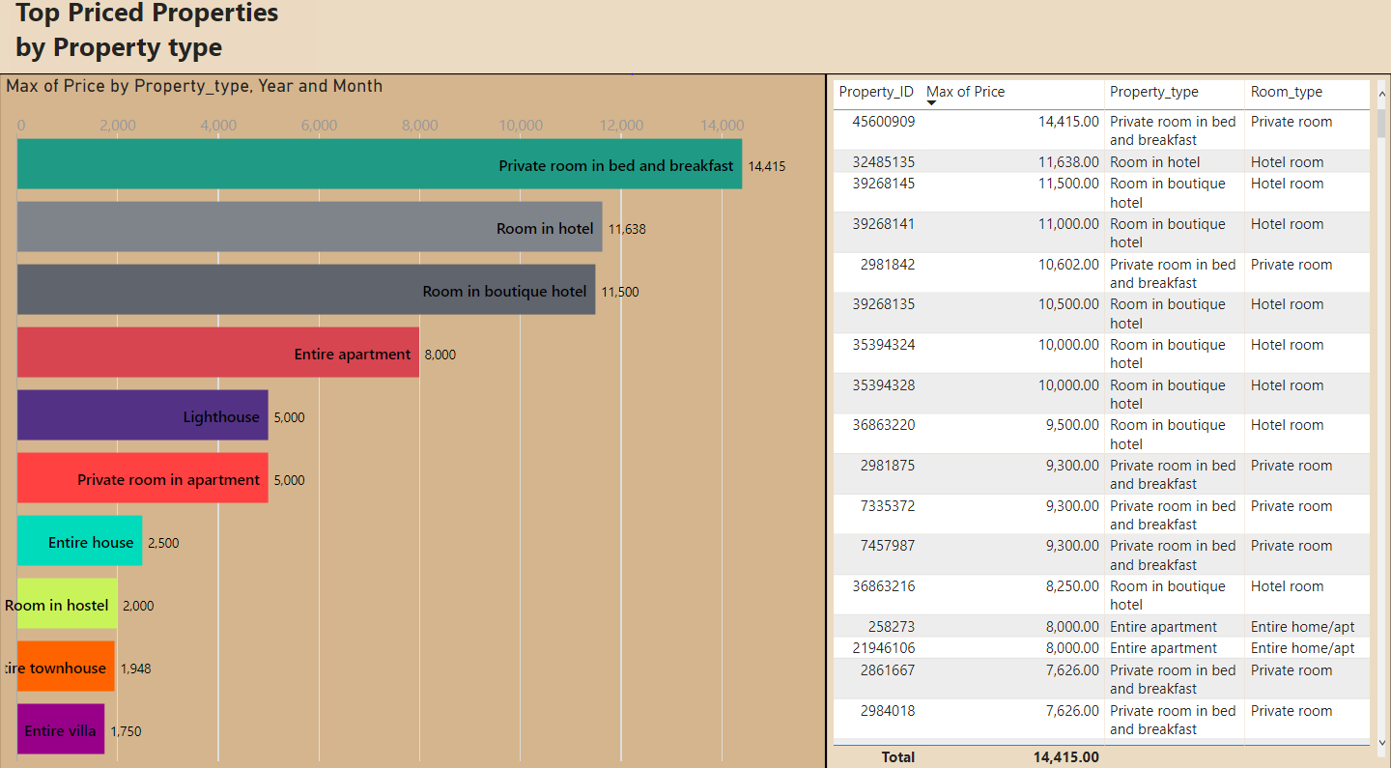
Top Priced Properties

Slide 9
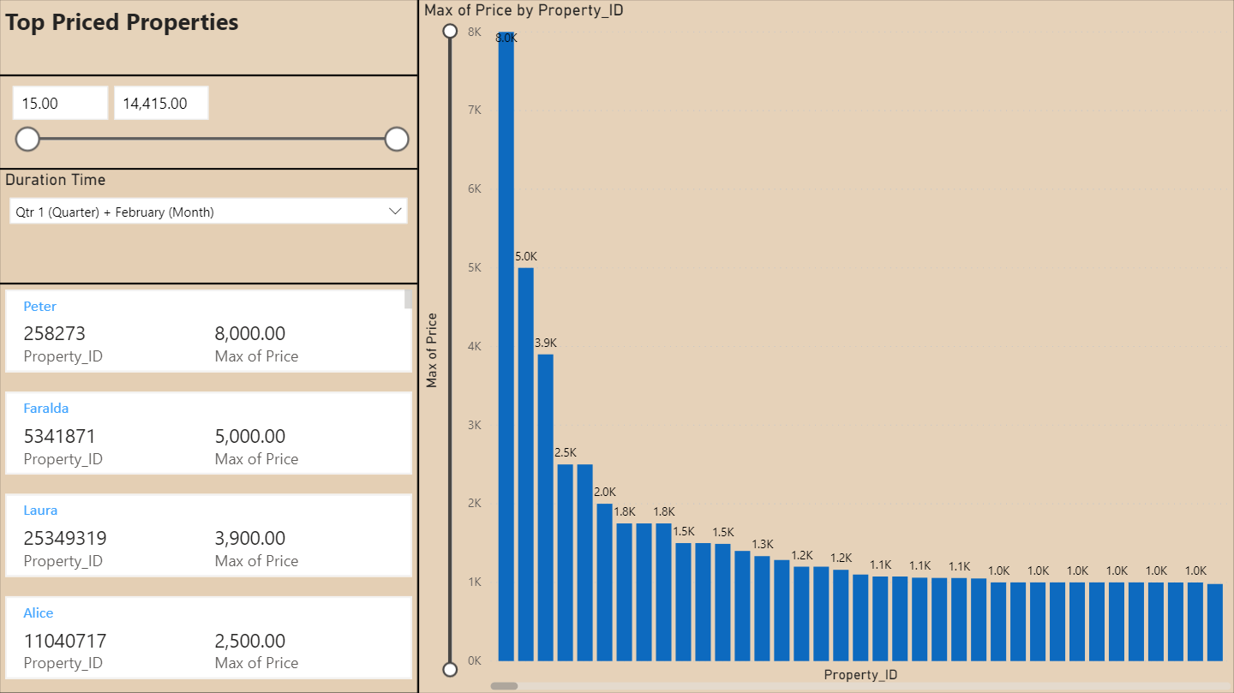
Top Priced Properties (2)

Slide 10
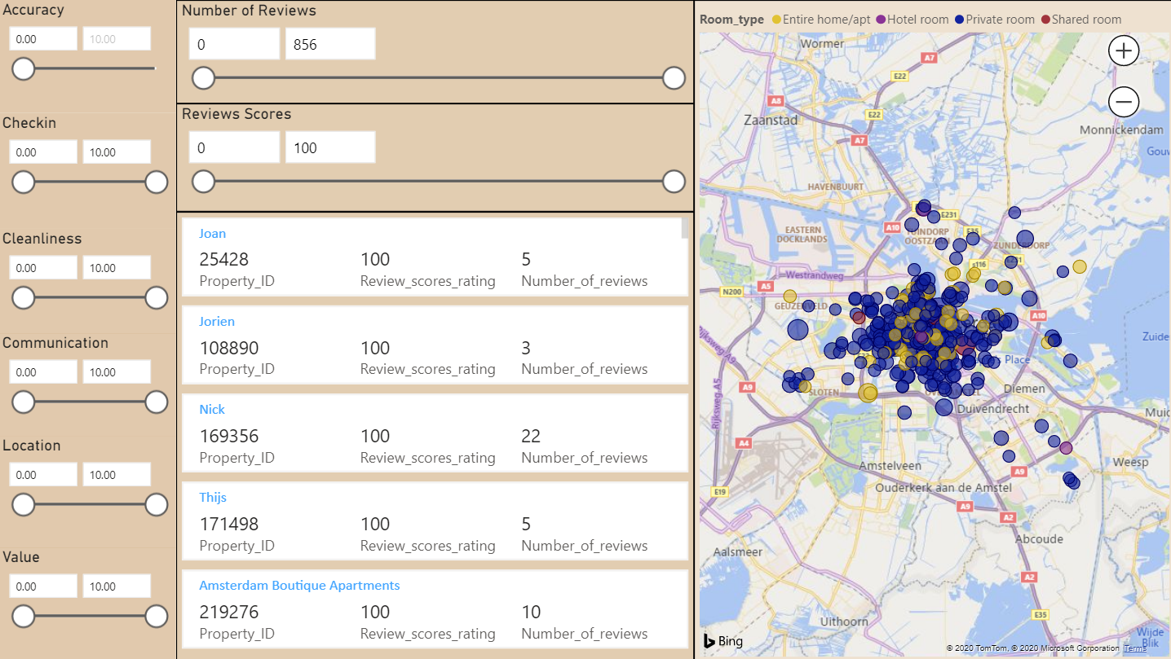
Top Rated Properties

Slide 11
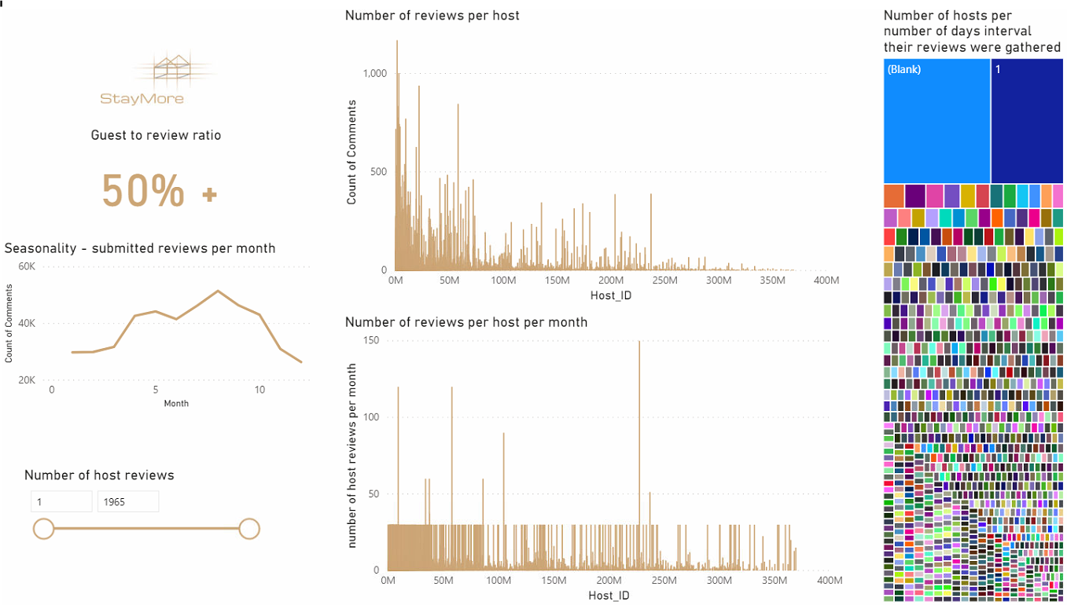
Busiest Hosts

Slide 12
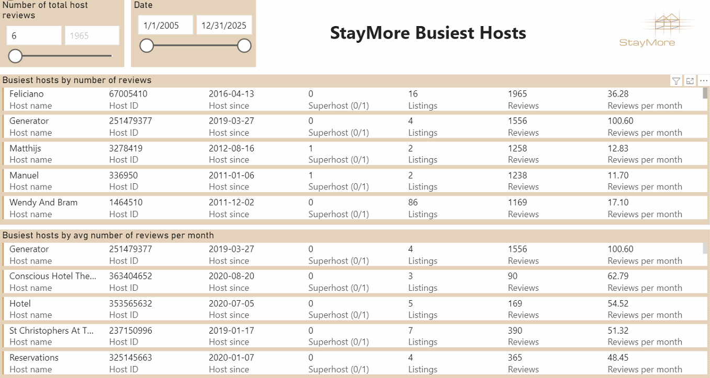
Busiest Hosts (2)

Slide 13
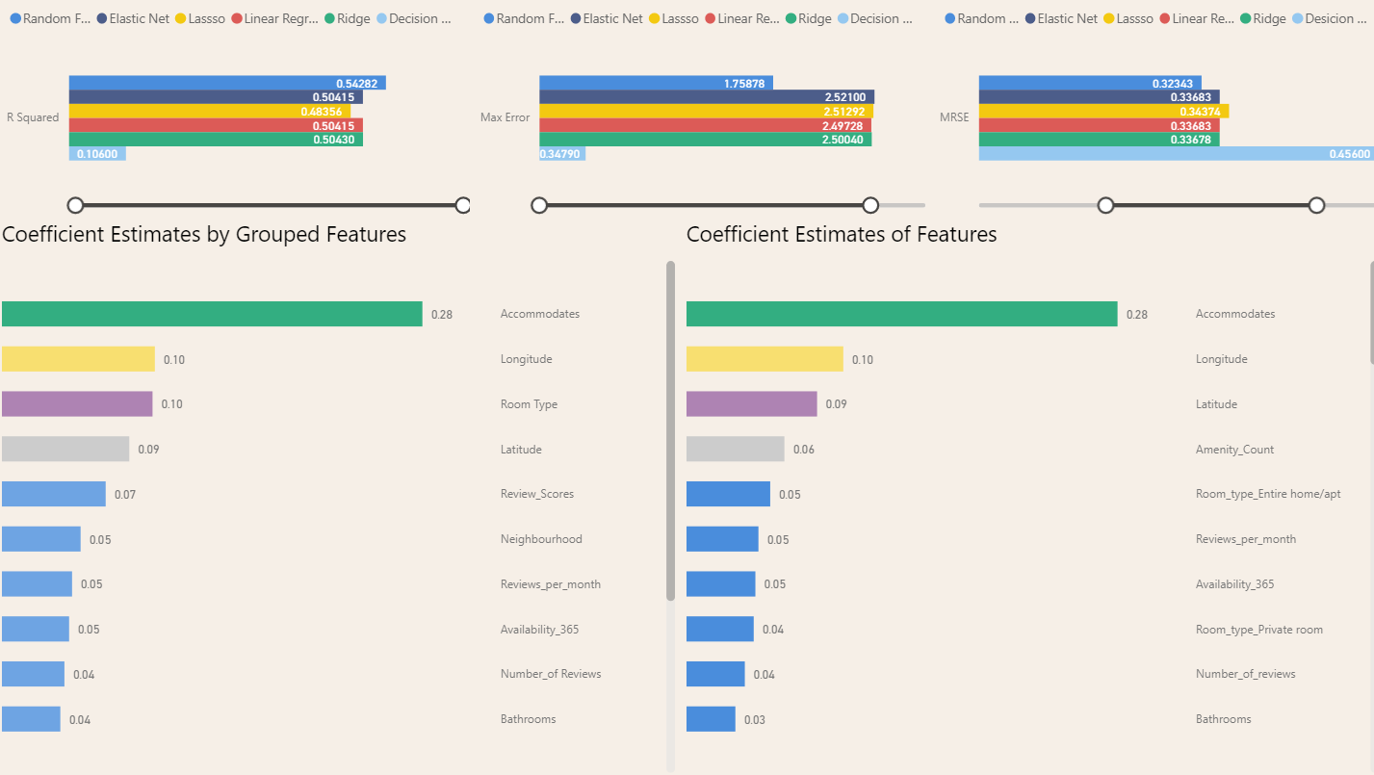
Property-Price Model
Machine Learning model selection - Critical attributes for property pricing

Slide 14
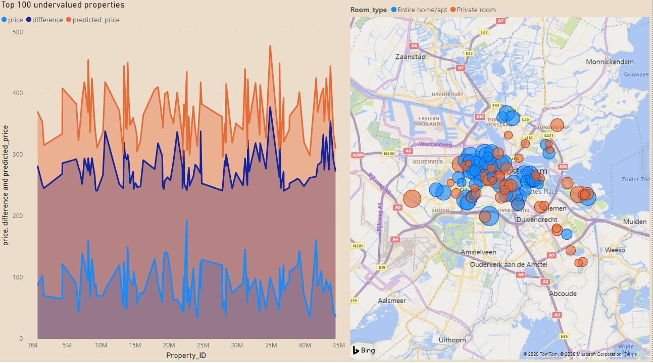
Data Predictions
Undervalued properties

Slide 15
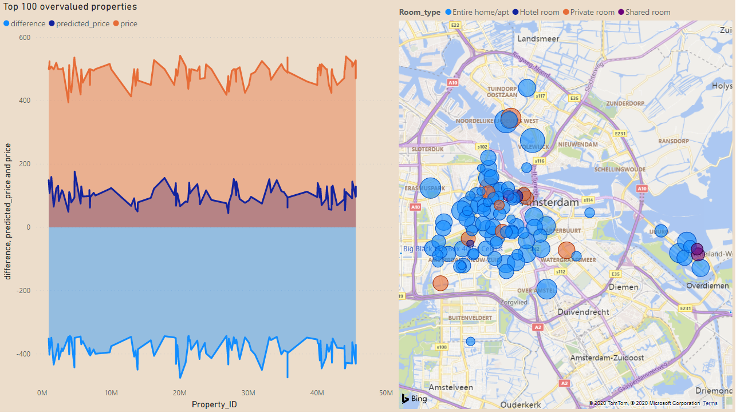
Data Predictions
Overvalued properties

Slide 16
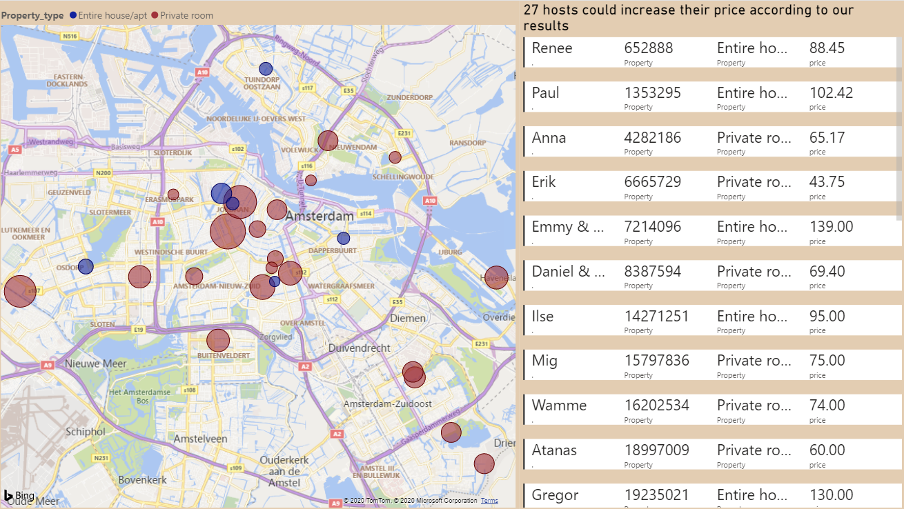
Data Predictions

Slide 17
Conclusions & Suggestions
Conclusions:
“Private room in bed and breakfast” properties are the top priced among other categories
Peter (258273) has the top priced room with 8K per night
Feliciano (67005410) is the all-time busiest host with 1965 number of reviews
The random decision forest model outperformed all other regression models in a property-price prediction model
We utilised the model to find the undervalued/overvalued properties and notify hosts with appropriate rating that could increase their price
Future Suggestions:
OLAP creation & Data Marts utilization
Alternate Dimension type in DW to enable attributes updates
More live dashboards
Monthly reports for each host about their properties
Proposed expansion of ML
Classification on clustered price values (more evaluation metrics)
Sentiment analysis in reviews’ comments to identify positive and negative reviews

Slide 18


Thanks for your attention
Questions?

